Slide 1
Generative AI to Assess Learning
AI-Driven Educational Ecosystems
Akpobari Godpower, Alex Vongphandy, Drake Rippey, Abram Demo

Slide 2
Project Overview
Project Description
This project is a canvas integrated assessment tool that utilizes generative AI to quiz students on their understanding of course content using a chatbot interface.
Project Requirements
Automated Interactive Assessment Generation
Automated Assessment Grading
Integration with Canvas
Instructor needs to be able to review interactions
Notes:
Improve speakability
Overview of what the project is about and the what the problem the project is solving.
Add requirements
Title:Project Overview
Akpobari

Slide 3
User Experiences
Instructors
Configure topic, content, and rubric criteria
Conversational-testing like an oral exam
Answer questions through chat interface
Students
View student responses
View grade submitted by a student
View their score and responses in canvas.
Notes:
Explain instructor and student user experience.
Akpobari

Slide 4
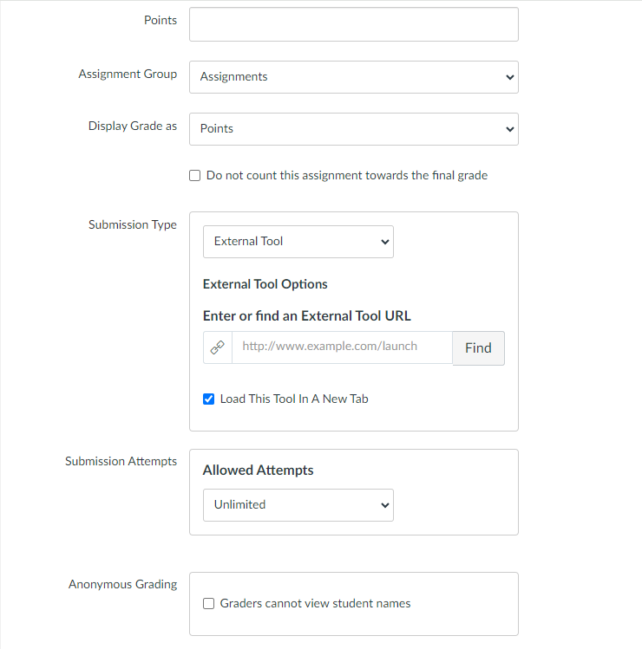
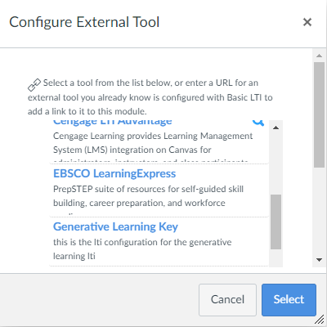
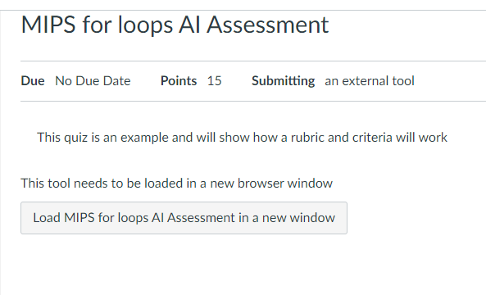
Create an assignment using the configured LTI
Select the LTI as the assignments External Tool
Save as an ‘External Tool’ type with open to new tab enabled
Canvas LTI Logic Flow
Notes:
Abram, about 20 seconds here

Slide 5
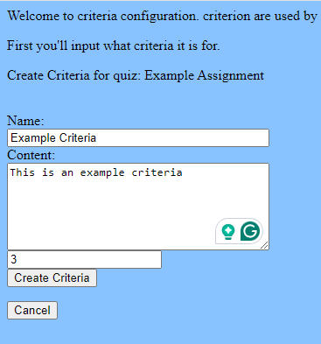
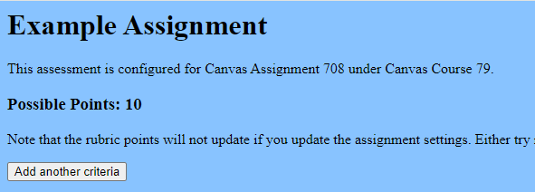
Canvas LTI Logic Flow
After clicking the assignment button, the instructor will be sent to the assignment details page where they can make edits
After hitting the ‘Add another criteria’ button, the instructor is taken to this page
Notes:
Abram, about 20 seconds here

Slide 6
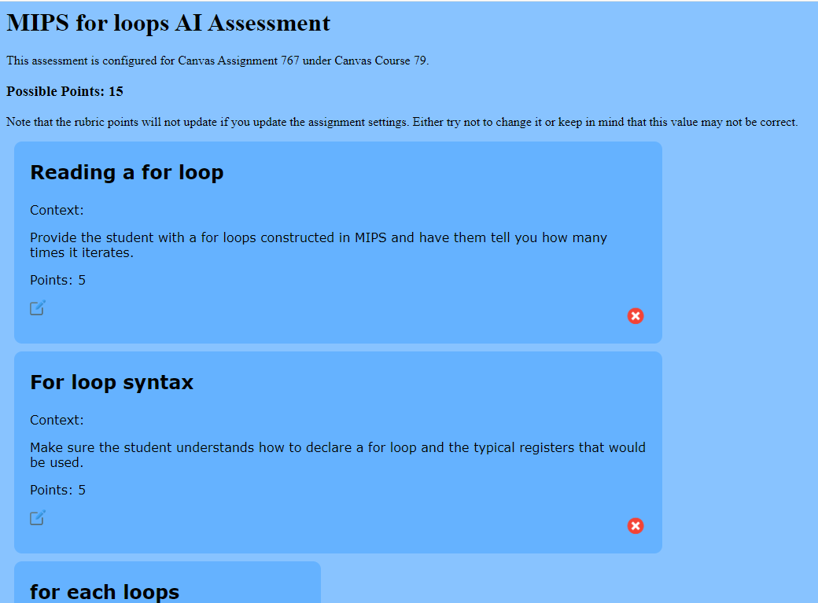
Canvas LTI Logic Flow
Example fully configured assessment
Notes:
Abram, about 10 seconds here

Slide 7
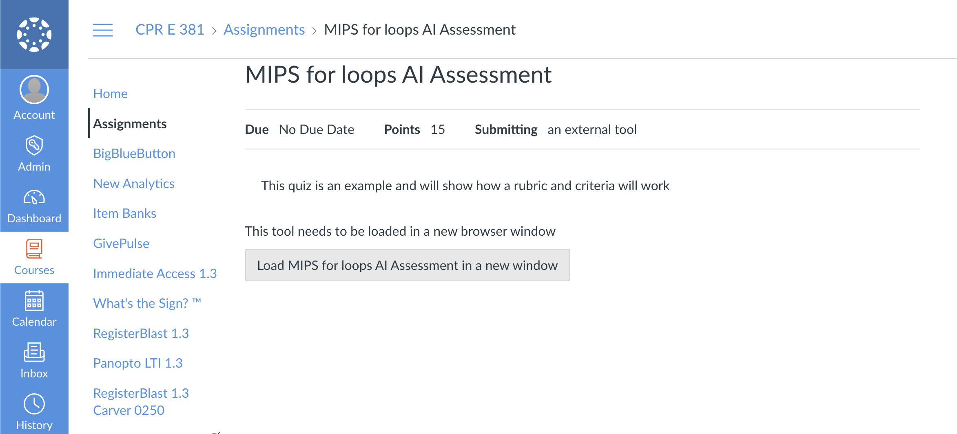
Chat Logic Flow
Notes:
Drake

Slide 8
On chat start:
Create agents and set agent for new user session.
Fetch rubric and criterion from the database.
Feed the fetched criterion and rubric into the generate_main_question task.
Display the generated main question to the user.
On chat message:
Numerate the current follow-up question
Determine whether to use the generate_main_question or generate_follow_up tasks based on the context and user interaction.
Chat Logic Flow
Notes:
Drake

Slide 9
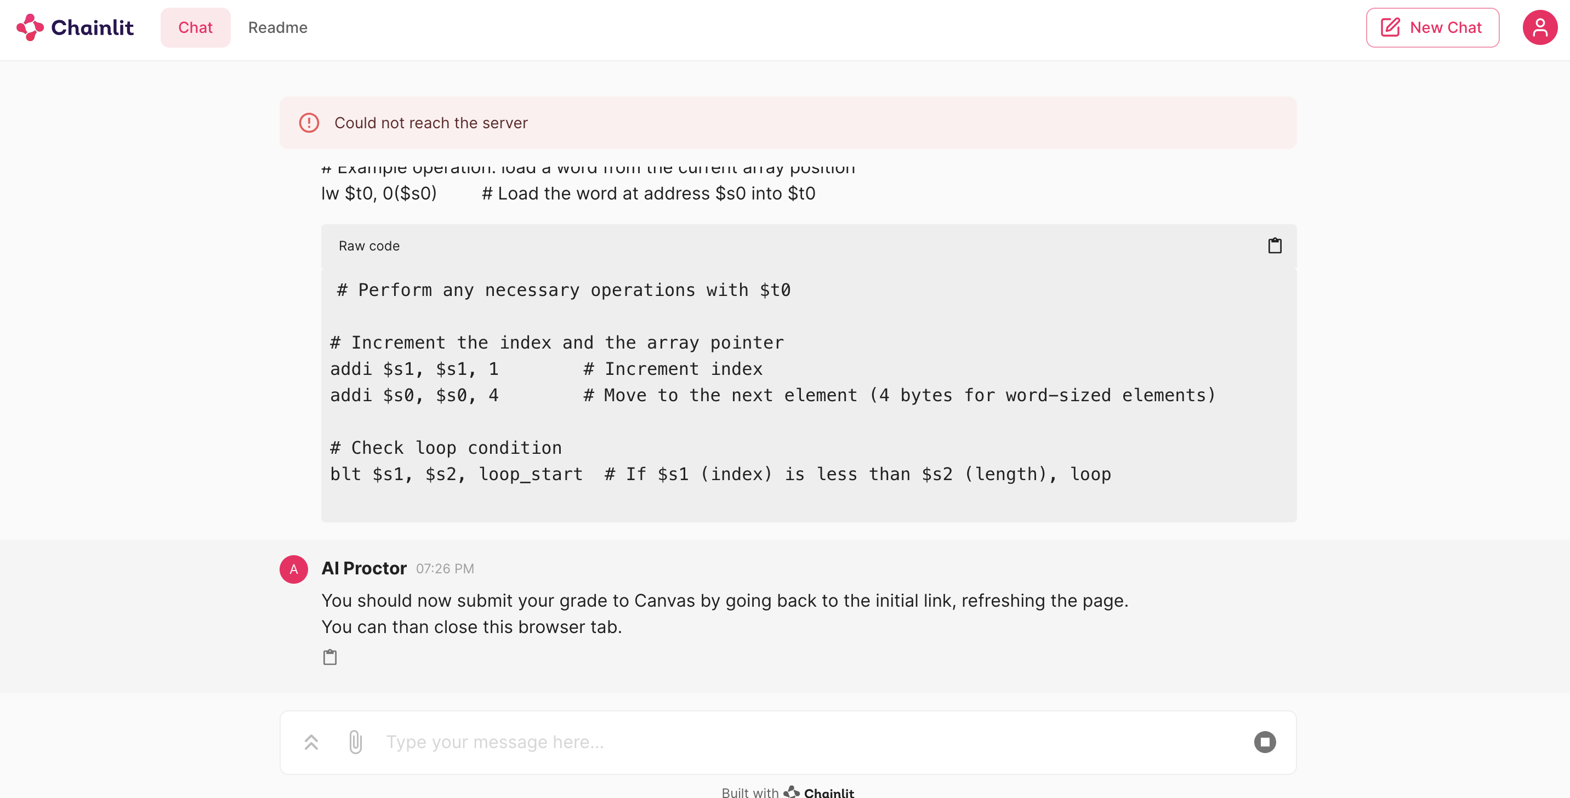
End Chat Logic Flow
Notes:
Drake

Slide 10
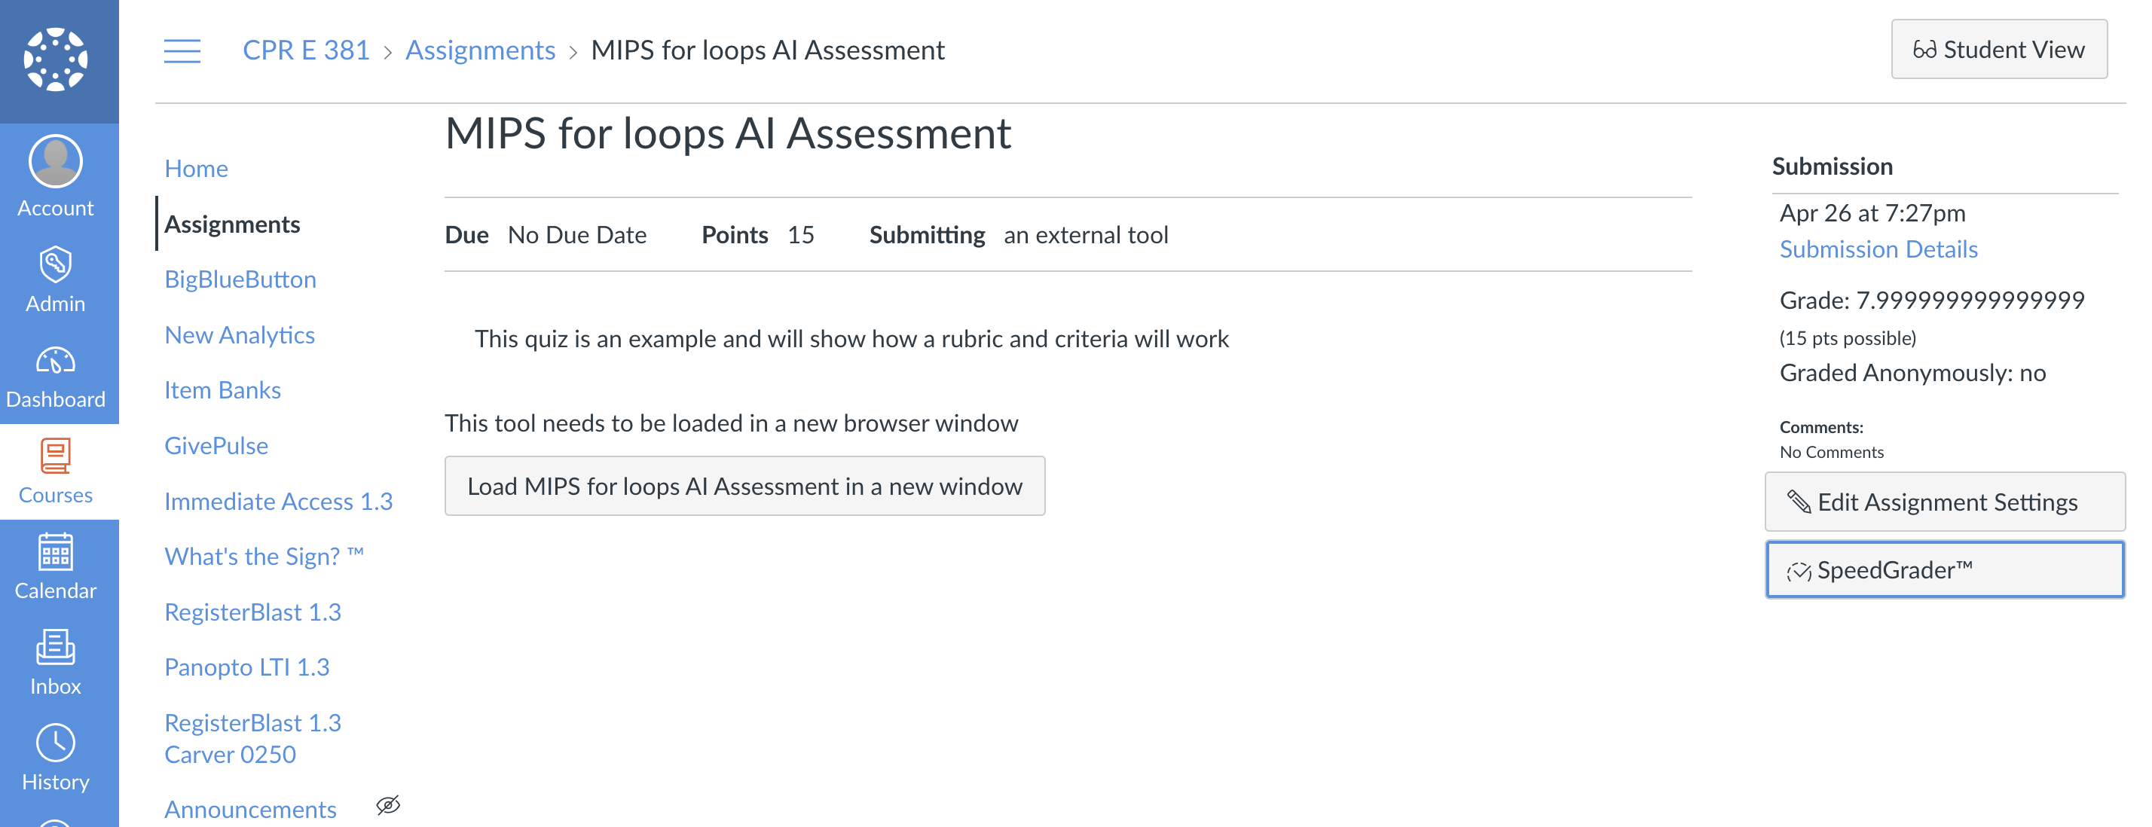
End Chat Logic Flow
Notes:
Drake

Slide 11
End Chat Logic Flow
Notes:
Drake

Slide 12
Demo
Notes:
Drake

Slide 13
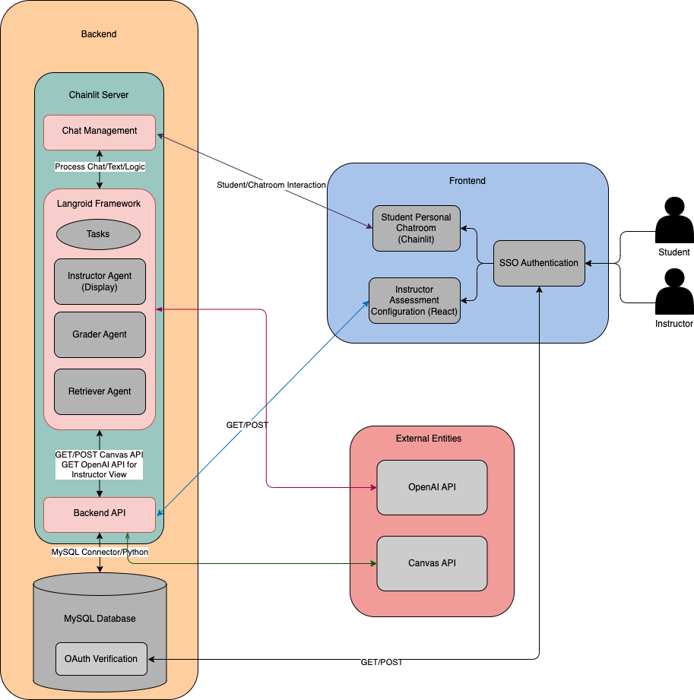
Detailed Design
Components
OpenAI
Langroid
GPT-4 Turbo
Chainlit
Session State
Agents
Tasks
Tools
Pydantic Model
Overriding Methods
Notes:
Drake

Slide 14
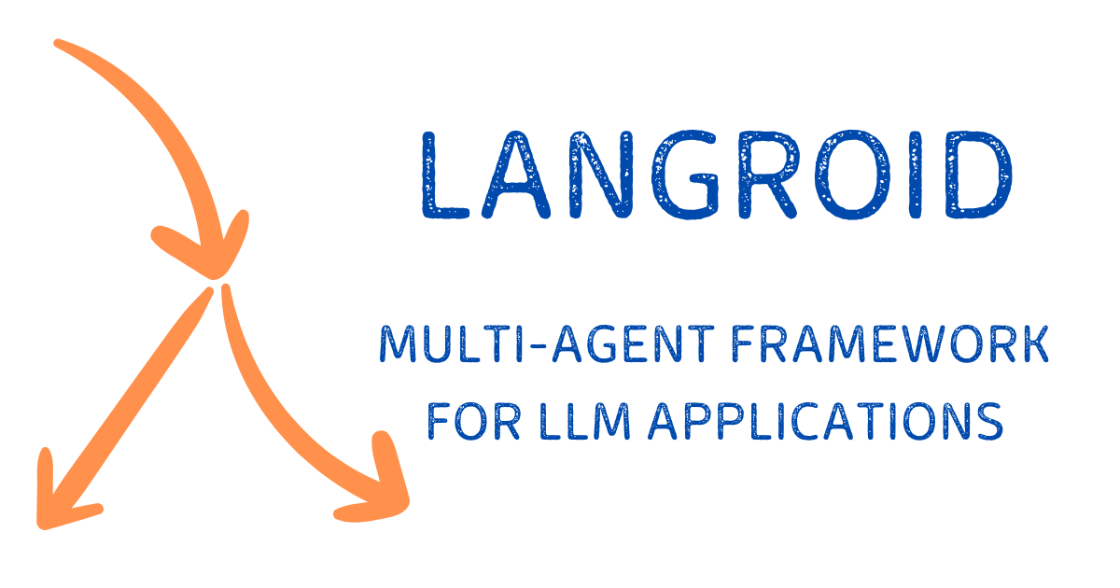
Langroid
Selection
Framework Swap
Langchain's Limitation
Open-Source
Custom Functions
More Consistent
Incorrect Tool/Function Calling
Reasoning + Act (ReAct) Agent
Notes:
Chat Agents are message transformers that handle interactions between the three responders which are message transformation methods that can be used.
There are three default responders in the Langroid framework, the LLM, the Agent, and the User. Each of these responders receive the message input and responds with a message.
LLM is the LLM response, Agent would be a tool or function-calling response, User would be retrieving manual input from the user. Chat Agents also handle message history which reduces the complexity of storing messages.
One of the benefits of using Langroid was that it was built to simplify the developer experience, which allowed us to override the Responders. In the original design of Langroid, it worked much like an interaction loop, but in our project, we did not want the user to directly interact with the LLM.
For our project we determined we wanted to create two Agents, one for Instructor and one for Grading to encapsulate chat history and tools. The Instructor agent handles the delivery and generation of the assessment and the Grader agent handles grading the assessment. We set two different temperatures for the OpenAI model, higher values will result in a more variance of output while lower temperatures make the output more deterministic. We set a temperature of .7 for the Instructor, and .1 for Grader to try to achieve a diverse but equal playing field.
While Agents handle message transformation and chat history, Tasks serve as an abstraction. I’ll discuss how Tasks are used in hand with Agents to deliver interactions.

Slide 15
Langroid
Added Benefits
AI Struggles to Gauge Progress
Langroid Custom Tools/Functions
Limit Follow-Up Questions
Langroid Chat History
Relevant Follow-Up
Track Confirmed Questions
Notes:
Chat Agents are message transformers that handle interactions between the three responders which are message transformation methods that can be used.
There are three default responders in the Langroid framework, the LLM, the Agent, and the User. Each of these responders receive the message input and responds with a message.
LLM is the LLM response, Agent would be a tool or function-calling response, User would be retrieving manual input from the user. Chat Agents also handle message history which reduces the complexity of storing messages.
One of the benefits of using Langroid was that it was built to simplify the developer experience, which allowed us to override the Responders. In the original design of Langroid, it worked much like an interaction loop, but in our project, we did not want the user to directly interact with the LLM.
For our project we determined we wanted to create two Agents, one for Instructor and one for Grading to encapsulate chat history and tools. The Instructor agent handles the delivery and generation of the assessment and the Grader agent handles grading the assessment. We set two different temperatures for the OpenAI model, higher values will result in a more variance of output while lower temperatures make the output more deterministic. We set a temperature of .7 for the Instructor, and .1 for Grader to try to achieve a diverse but equal playing field.
While Agents handle message transformation and chat history, Tasks serve as an abstraction. I’ll discuss how Tasks are used in hand with Agents to deliver interactions.

Slide 16
Langroid Components
Langroid Components (Agents)
Handles Interactions
Divided into two Agents
Instructor
Responders
Grader
Modified Interaction
Default Interaction Loop
[Agent, LLM, User]
Our Implementation
[Agent, LLM]
Notes:
Alex –
Moving onto Tasks, which are orchestrators for Agents. The Task’s main job is to invoke sequentially the responder methods, and in our case since we removed User, it would be the LLM and the Agent. There is a feature of Langroid that allows us to “chain” or have sub-tasks which tacks on the sub-task as a “entity” or Responder in the methods. So, the process would go through sequentially LLM, Agent, sub-task (if any). Tasks can also communicate between Agents, which is helpful when storing the conversation history into a source Agent.
The task is where we provide the system message, in our case, crafted from our prompt engineering to provide the AI with feedback or instructions. The task will keep looping through the responders until it finds a valid response, or meaningful response.
In our project we have four main tasks, generating a follow up question, generating a main question, detecting malicious activity, and redirecting off-topic responses. What makes the follow-up task unique task is that it chains together generating the follow up, detecting malicious response, and detecting and redirecting off-topic responses. It does this all with one statement. This proactively checks for those two scenarios and responds accordingly with the tools before generating a follow up. We have made some configuration changes to the Tasks to only stop when the Agent responds, in this case, a tool. I’ll explain why we need custom tools and how tools affect our project.

Slide 17
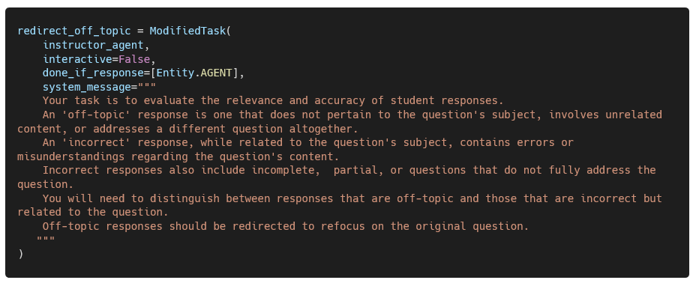
Langroid Components
Langroid Components (Tasks)
generate_follow_up
malicious_activites
off_topic_redirect
Loops Through Responders
Stop at Valid Responses
Divided into four tasks
generate_main_question
Chaining Tasks
Example Task Structure
generate_follow_up.add_sub_task([redirect_off_topic,malicious_activities])
Notes:
Alex –
Moving onto Tasks, which are orchestrators for Agents. The Task’s main job is to invoke sequentially the responder methods, and in our case since we removed User, it would be the LLM and the Agent. There is a feature of Langroid that allows us to “chain” or have sub-tasks which tacks on the sub-task as a “entity” or Responder in the methods. So, the process would go through sequentially LLM, Agent, sub-task (if any). Tasks can also communicate between Agents, which is helpful when storing the conversation history into a source Agent.
The task is where we provide the system message, in our case, crafted from our prompt engineering to provide the AI with feedback or instructions. The task will keep looping through the responders until it finds a valid response, or meaningful response.
In our project we have four main tasks, generating a follow up question, generating a main question, detecting malicious activity, and redirecting off-topic responses. What makes the follow-up task unique task is that it chains together generating the follow up, detecting malicious response, and detecting and redirecting off-topic responses. It does this all with one statement. This proactively checks for those two scenarios and responds accordingly with the tools before generating a follow up. We have made some configuration changes to the Tasks to only stop when the Agent responds, in this case, a tool. I’ll explain why we need custom tools and how tools affect our project.

Slide 18
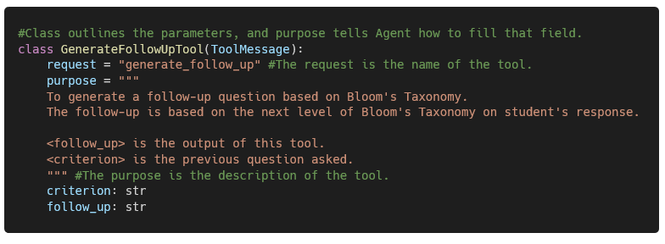
Langroid Components
Langroid Components (Tools)
Pydantic Models
Structured
JSON Format
Defined Fields
Tool Formatted for Tasks
Custom Functionality
Notes:
Alex
After explaining how tasks flow information among agents and sub-tasks let’s talk about tools. Since LLMs under normal conditions generate unstructured output, we wanted functionality that would allow us to deliver a clear and structured responses that did not include any nonces. We can achieve this by using Langroid Tool’s which allows us to instruct the LLM how to format its output using Pydantic models, or rather simply, JSON format. These Tools are loaded to the Agent which looks at the purpose variable to identify how the tool should be used and when to use it.
When we switched from a previous framework, which we will discuss later, we found that there was no ability to create custom functions when dealing with scenarios. Let’s take for example, we want to respond to a user but we only want the interaction to last 5 rounds, how do we instruct the LLM to act on this with Python? What happens if the user was way off-topic, do you count the LLM’s response as follow up? The solution was Langroid’s Tools.
In our generate_follow_up custom function which is called from the tool, we are able to increment a counter and keep track of our current state using Chainlit session. This allowed us to accurate track the amount of follow-up questions and increment only when needed. In our project we use 5 tools to control the interaction to ensure consist responses and state, most related to their respective tasks but are directed to deliver a formatted response.
The following slide will provide an overview on how the Langroid components work all together.

Slide 19
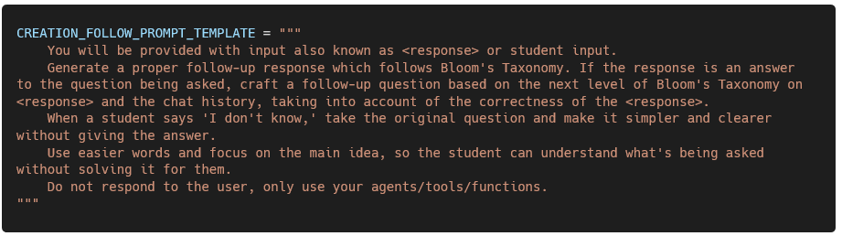
Prompt Engineering
Basis – OpenAI Strategies
Persona
Clarity
External Inputs
Criterion
Background
Response
Testing
Prompt template refinement
Notes:
Akpobari Highlight important aspects of prompt

Slide 20
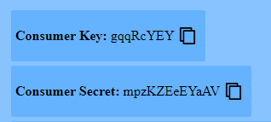
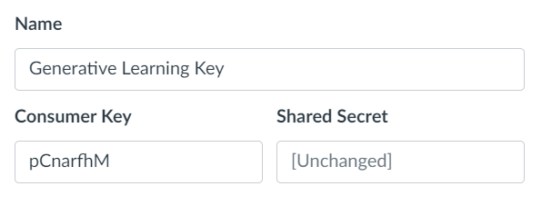
FERPA and OAuth
To be compliant with both FERPA and Iowa State requirements for use of student information as an internal software, we must ensure that information is only sent using secure HTTPS requests and protected using OAuth.
OAuth Process
Canvas sends a POST request with a consumer key and OAuth signature
The backend finds the needed consumer secret using the consumer key
The secret is then used to generate the OAuth signature
If the signatures match, the request can proceed
Notes:
Abram

Slide 21
Conclusion
What we Accomplished
We created a customizable Generative AI Quizbot that is able to evaluate a student's understanding of any specified topic while also prompting the student to provide reasoning behind their answers.
In doing this we used our comprehensive adaptability skills and communicated with our team and client effectively. All to design, develop, and produce a working AI-Driven Educational Environment that not only assists instructors with catering their assignments to their students, but also provides students with a in-depth assessment that will ultimately enhance their academic experience
Notes:
Drake

